Slide 1
1
Machine learning
What is ML
Machine learning is a subfield of artificial intelligence ,which is broadly defined as the capability of a machine to imitate intelligent human behavior.
AI systems are used to perform complex tasks in a way that is similar to how humans solve problems
But in some cases ,writing a program for the machine to follow is time consuming or impossible ,such as training a computer to recognize picture of different people. while human can do this task easily it is difficult to tell a computer how to do it .machine learning takes the approach of letting computers learn to program themselves through experience

Slide 2
2
Machine learning
Functions of Machine learning
Descriptive: The system uses the data to explain what happened
Predictive: The system uses the data to predict what will happened
Prescriptive: The system will use the data to make suggestions about what action to take

Slide 3
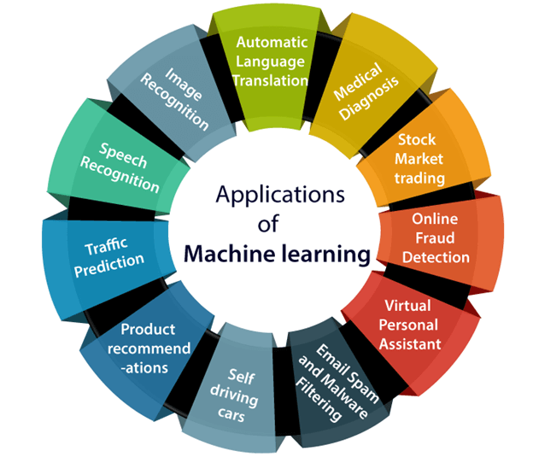
3
Machine learning
Applications of Machine learning algorithms

Slide 4
4
Machine learning
Applications where machine learning algorithms used
Speech recognition: Machine learning can translate speech into text. Certain software applications can convert live voice and recorded speech into a text file
Real-world examples of speech recognition:
Voice search
Voice dialing
Appliance control
Some of the most common uses of speech recognition software are devices like Google Home or Amazon Alexa

Slide 5
5
Machine learning
Applications where machine learning algorithms used
Image recognition: Image recognition is a well-known and widespread example of machine learning in the real world. It can identify an object as a digital image, based on the intensity of the pixels in black and white images or colour images.
Real-world examples of Image recognition :
Label an x-ray as cancerous or not

Slide 6
6
Machine learning
Why python is best language for machine learning
Python is more suitable for machine learning ,artificial intelligence and data science because of the ease of use ,accessibility and simplicity.
Python require lesser codes and can compile even when there are bugs in your code
Python allows easy and powerful implementation
Also python come with large number of libraries.
Some of the libraries are
Scikit-learn-for data mining ,analysis, and machine learning
Tensorflow,a high level neural network library

